Slide 1
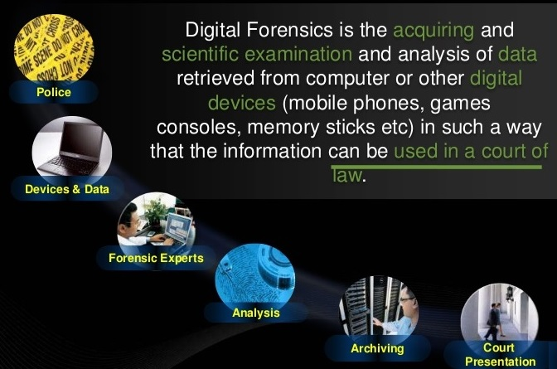
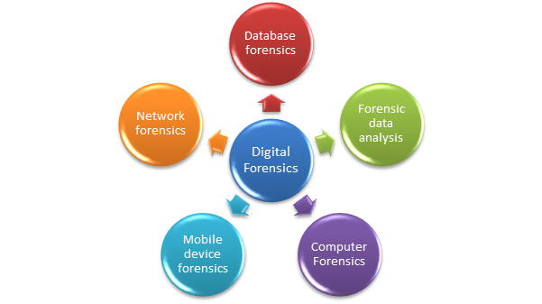
What is Digital Forensics?

Slide 2
Define forensics
Forensics is the scientific analysis of people, places and things to collect evidence during crime investigations, that helps to prove innocence or guilt in court.

Slide 3

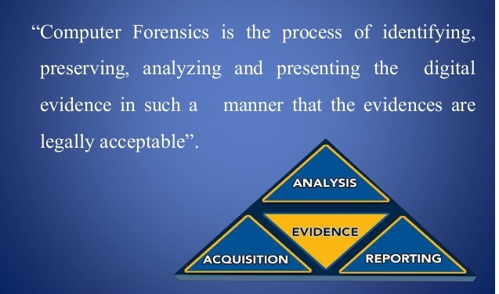
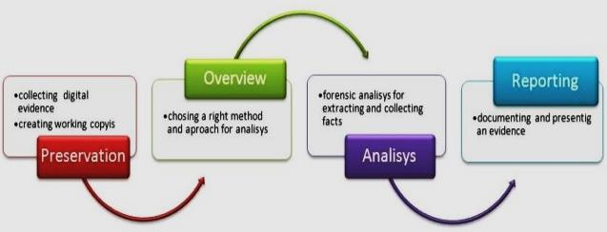
What is Computer Forensics?

Slide 4
What then is computer/ digital forensics
Computer Forensics is a branch of forensic science also called digital forensics, has a like purpose. But it specializes in the scientific analysis of computer, communications and the data on computer storage devices, such as disks and CD-ROMs.

Slide 5
Need for Digital Forensic
Computer forensics offers the following benefits to organizations:
Ensures the overall integrity and continued existence of an organization’s computer system and network infrastructure.
Helps the organization capture important information if their computer systems or networks are compromised. It also helps prosecute the case, if the criminal is caught.
Extracts, processes, and interprets the actual evidence in order to prove the attacker’s actions and the organization’s innocence in court.
Efficiently tracks down cyber criminals and terrorists from different parts of the world. Cyber criminals and terrorists that use the Internet as a communication medium can be tracked down and their plans known. IP addresses play a vital role in determining the geographical position of terrorists.
Saves the organization money and valuable time. Many managers allocate a large portion of their IT budget for computer and network security.
Tracks complicated cases such as child pornography and e-mail spamming.

Slide 6
DIGITAL INVESTIGATION RULES AND REGULATIONS
No possible evidence is damaged, destroyed, or compromised by the forensic procedures used to investigate the computer (preservation of evidence).
No possible computer malware is introduced to the computer being investigated during the analysis process (prevention of contamination of evidence).
Any extracted and possibly relevant evidence is properly handled and protected from later mechanical or electromagnetic damage (extraction and preservation of evidence).
A continuing chain of custody is established and maintained (accountability of evidence).
Normal operations are affected for a limited period of time, if at all (limited interference of the crime scene on normal life).
Details of the client-attorney relationship are not disclosed if obtained during a forensic process in order to maintain professional ethics and legality (ethics of investigation).

Slide 7
Uses of Digital Forensic
Criminal Investigations includes Bind. Torture. Kill [BTK] case.
Civil Litigation – use of digital forensics in civil cases in big business.
Intelligence – uses to extract information about terrorists and foreign governments to communicate, recruit, and plan attacks. This process is known as DOMEX (Document and Media Exploitation). Ex. Moussaoui -9/11 plane attack
Administrative Matters: to observe employee operating a personal side business, using company computers while on company times. SEC (Securities and Exchange Commission)

Slide 8
Roles of CFI / Uses of Digital Forensic
Criminal Prosecutors
  Child Pornography cases
  Homicides
  Embezzlement
  Financial Fraud
Civil Litigations
  Fraud
  Divorce
  Breach of Contract
  Copy right
Insurance Companies
  False Accident Reports
  Workman’s Compensation Cases

Slide 9
Roles of CFI / Uses of Digital Forensic
Large Corporations
  Embezzlement
  Insider Trading
Law Enforcement
Any Individual
  Claims
    Sexual harassment
    Age discrimination
    Wrongful termination from job
    Background checks

Slide 10
Key Steps in a Forensic Investigation
The following procedure explains the steps involved in a forensic investigation:
The investigation is initiated the moment the computer crime is suspected.
The immediate response is to collect preliminary evidence. This includes photographing the scene and marking the evidence.
A court warrant for seizure (if required) is obtained.
First responder procedures are performed.
Evidence is seized at the crime scene. After seizure, the evidence is numbered and safely secured.
The evidence is securely transported to the forensic laboratory.
Two bit-stream copies of the evidence are created. The original disk must not be tampered with as it might change the time stamps.
An MD5 checksum is generated on the images.
A chain of custody is prepared. Any change to this chain calls into question the admissibility of the evidence.
The original evidence is stored in a secure location, preferably away from an easily accessible location.
The image copy is analyzed for evidence.
A forensic report is prepared. It describes the forensic method and recovery tools used.
The report is submitted to the client.
If required, the investigator may attend court and testify as an expert witness.

Slide 11
Tasks performs by Forensic Investigator
Determines the extent of any damage done during the crime
Recovers data of investigative value from computers involved in crimes
Gathers evidence in a forensically sound manner
Ensures that the evidence is not damaged in any way
Creates an image of the original evidence without tampering with it to maintain the original evidence’s integrity
Guides the officials in carrying out the investigation. At times, it is required that the forensic investigator produce the evidence, describing the procedure involved in its discovery.
Reconstructs the damaged disks or other storage devices, and uncovers the information hidden on the computer
Analyzes the evidence data found
Prepares the analysis report
Updates the organization about various attack methods and data recovery techniques, and maintains a record of them (following a variant of methods to document) regularly
Addresses the issue in a court of law and attempts to win the case by testifying in court

Slide 12
Role of Digital Evidence
When intruders bypass the security settings of a victim’s computer or network, they often leave evidence that can serve as clues to document the attack. Certain factors that can contain valuable evidence include:
Use/abuse of the Internet, indicating the intruder probably exchanged some type of communication or was able to install malware on the victim’s computer
Production of false documents and accounts, which indicates that the intruder is probably concealing something
Encrypted or password-protected material, which indicates that the intruder is transferring or hiding some secret information
Abuse of the systems, as when the attacker is using the victim’s computer as a zombie or bot to further the attacker’s criminal activity
E-mail contact between suspects/conspirators, which could indicate that more than one intruder is involved and that some sort of collusion has taken place.
Theft of commercial secrets or proprietary information
Unauthorized transmission of confidential information
Records of movements within the company, allowing the attacker to benefit from insider knowledge
Malicious attacks on the computer systems themselves, up to and including denial-of-service attacks
Stealing names and addresses of the user’s or company’s contacts

Slide 13
Locard's Exchange Principle
Locard's exchange principle says that in the physical world, when perpetrators enter or leave a crime scene, they will leave something behind and take something with them. Examples include DNA, latent prints, hair, and fibers.
The same holds true in digital forensics. Registry keys and log files can serve as the digital equivalent to hair and fiber. Viewing a device or incident through the “lens” of Locard's principle can be very helpful in locating and interpreting not only physical but digital evidence as well.

Slide 14
Organization of Note
There are several organizations that make significant contributions to the discipline of digital forensics year in and year out. These organizations not only set standards and establish best practices, they provide leadership as well. Examiners should be familiar with these entities, the roles they play, and the contributions they make. As professionals, it's our responsibility to participate in one or more of these organizations.
  Scientific Working Group on Digital Evidence
  American Academy of Forensic Sciences
  American Society of Crime Laboratory Directors/Laboratory Accreditation Board
  National Institute of Standards and Technology (NIST)
  American Society for Testing and Materials (ASTM)

Slide 15
Organizations of Note
1. Scientific Working Group on Digital Evidence
Formed in 1998, the Scientific Working Group on Digital Evidence (SWGDE) is made up of “federal government agency, state or local law enforcement agency involved in the digital and multi-media forensic profession”

Slide 16
Organizations of Note
Scientific Working Group on Digital Evidence
The mission of SWGDE is as follows:
“Brings together organizations actively engaged in the field of digital and multimedia evidence to foster communication and cooperation as well as ensuring quality and consistency within the forensic community”

Slide 17
Organizations to Note
Scientific Working Group on Digital Evidence
http://www.swgde.org/
The federal Bureau of Investigation has supported formation of :
  Scientific Working Groups (SWGs)
  Technical Working Groups (TWGs)

Slide 18
Organizations of Note
Scientific Working Group on Digital Evidence
These collaborative groups draw their members from “forensic, industrial, commercial, academic and in some cases international communities”
  Scientific Working Group for DNA Analysis Methods (SWGDAM)
  Scientific Working Group for Firearms and Toolmarks (SWGGUN).
  Digital evidence has now joined the party with the formation of SWGDE.

Slide 19
Organizations of Note
American Academy of Forensic Sciences
http://www.aafs.org/
AAFS is considered the premier forensic organization in the world. Members of the Academy work for :
  National Institute of Standards and Technology (NIST)
  National Academy of Sciences (NAS).

Slide 20
Organizations of Note
American Academy of Forensic Sciences
The directors of most federal crime labs are members of AAFS. Members of AAFS are also active in the various Scientific Working Groups including SWGDE.
The Academy plays a critical role in developing standards of practice for the forensic community.

Slide 21
Organizations of Note
American Academy of Forensic Sciences
The AAFS has approximately six thousand members and is divided into “eleven sections spanning the forensic enterprise.”

Slide 22
Organizations of Note
American Society of Crime Laboratory Directors/Laboratory Accreditation Board
http://www.ascld-lab.org/index.htm
ASCLD/LAB (pronounced as-clad lab).
  The ASCLD is to forensic laboratories.
  ASCLD/LAB is the “oldest and most well known crime/forensic laboratory accrediting body in the world.”
  A lab becomes accredited only after successfully meeting all of the standards and requirements set forth in the ASCLD/LAB accreditation manual.

Slide 23
Organizations of Note
National Institute of Standards and Technology (NIST)
http://www.nist.gov/itl/ssd/computerforensics.cfm
National Institute of Standards and Technology (NIST) was founded in 1901 and is a part of the U.S. Department of Commerce. It was the first federal physical science research laboratory.
NIST's areas of focus include
  bioscience and health, chemistry, physics, math, quality, and information technology

Slide 24
Organizations of Note
NIST is heavily involved in digital forensics. Some of the programs and projects include:
  National Initiative Cyber Security Education (NICE)—A national cyber security education program teaching sound cyber practices that will improve the country's security.
  National Software References Library—A collection of known software file signatures that can be used by examiners to quickly exclude files that have no investigative value. This would include things like operating system files.
  Computer Forensic Tool Testing—Intended to develop testing methodologies and standards for forensic hardware and software.

Slide 25
Organizations of Note
American Society for Testing and Materials (ASTM)
http://www.astm.org/Standards/E2763.htm
Another major player in the development of standards is ASTM.
  ASTM is a global organization that has developed approximately twelve thousand standards that are used to “improve product quality, enhance safety, facilitate market access and trade, and build consumer confidence.”
  ASTM, founded in 1898, comprises about 30,000 members broken into 141 committees. The Forensics Sciences committee, known as E30, is further divided into several subcommittees. The Digital and Multimedia Evidence subcommittee is known as E30.12 (ASTM).

Slide 26
Role of Forensic Examiner in Judicial System
Digital Forensics Practitioner plays role of an expert witness, because non-forensic witnesses can only testify to what they did or saw but they do beyond that.
CFI Experts, by contrast, can and often do give their opinion.
In the legal sense, it's someone who can assist the judge or jury to understand and interpret evidence they may be unfamiliar with. To be considered an expert in a court of law, one doesn't have to possess an advanced academic degree.
An expert must have particular subject knowledge than average person. Under the legal definition, a doctor, scientist, baker, or garbage collector could be qualified as an expert witness in a court of law.
Individuals are qualified as experts by the court based on their training, experience, education, and so on.

Slide 27
Role of Forensic Examiner in Judicial System
What separates a qualified expert from a truly effective one?
It is their ability to communicate with the judge and jury.
They must be effective teachers. The vast majority of society lacks technical understanding to fully grasp this kind of testimony without at least some explanation.
Digital forensic examiners must carry out their duties without bias.
Lastly, a digital forensics examiner must go where the evidence takes them without any preconceived notions.

Slide 28
Computer/Digital Forensics Tools
Computer forensics is a very important branch of computer science in relation to computer and Internet related crimes. The goal of Computer forensics is to perform crime investigations by using evidence from digital data to find who was the responsible for that particular crime. For better research and investigation, developers have created many computer forensics tools. Police departments and investigation agencies select the tools based on various factors including budget and available experts on the team.
These computer forensics tools can also be classified into various categories:
Disk and data capture tools
File viewers
File analysis tools
Registry analysis tools
Internet analysis tools
Email analysis tools
Mobile devices analysis tools
Mac OS analysis tools
Network forensics tools
Database forensics tools

Slide 29

Computer/Digital Forensics Tools
Following are the list of few important and popular computer/Digital forensics tools which are available in market out of which few of them we are going to do in practical
1. Digital Forensics Framework (DFF):
DFF (Digital Forensics Framework) is a Forensics Framework coming with command line and graphical interfaces. DFF can be used to investigate hard drives and volatile memory and create reports about user and system activities.
Digital Forensics Framework is another popular platform dedicated to digital forensics. The tool is open source and comes under GPL License. It can be used either by professionals or non-experts without any trouble. It can be used for digital chain of custody, to access the remote or local devices, forensics of Windows or Linux OS, recovery hidden of deleted files, quick search for files’ meta data, and various other things.
2. Bulk Extractor (DFF):
Bulk Extractor is also an important and popular digital forensics tool. It scans the disk images, file or directory of files to extract useful information. In this process, it ignores the file system structure, so it is faster than other available similar kinds of tools. It is basically used by intelligence and law enforcement agencies in solving cyber crimes.
Bulk Extractor Viewer (BEViewer) is a User Interface for browsing features that have been extracted via the bulk extractor feature extraction tool. BEViewer supports browsing multiple images and bookmarking and exporting features. BEViewer also provides a User Interface for launching bulk extractor scans.

Slide 30
3. Memory Forensics:
Memory forensics is forensic analysis of a computer's memory dump. Its primary application is investigation of advanced computer attacks which are stealthy enough to avoid leaving data on the computer's hard drive. Consequently, the memory(RAM) must be analyzed for forensic information.
It includes three important tools
Process Hacker to Hack memory process of your computer
Memory Dumpit Tool
Volatility Tool
Sample Memory Dump https://github.com/volatilityfoundation/volatility/wiki/Memory-Samples
4. FTK Imager:
FTK® Imager is a data preview and imaging tool used to acquire data (evidence) in a forensically sound manner by creating copies of data without making changes to the original evidence. After you create an image of the data, use Forensic Toolkit® (FTK®) to perform a thorough forensic examination and create a report of your findings.
5. Autopsy:
Autopsy® is a digital forensics platform and graphical interface to The Sleuth Kit® and other digital forensics tools. It is used by law enforcement, military, and corporate examiners to investigate what happened on a computer. You can even use it to recover photos from your camera's memory card.
5. Encase:
EnCase is the shared technology within a suite of digital investigations products by Guidance Software. The software comes in several products designed for forensic, cyber security, security analytics, and e-discovery use.

Slide 31
What should/can a CFI do?
As part of the legal system, a computer forensics investigator helps build a case for or against a person or company accused of wrongdoing. Jobs that a computer forensics investigator might take on include those in the following list:

Slide 32
What should/can a CFI do?
Examine the prosecution's or opposing counsel's e-evidence for alternative interpretations.
Assess the strength of the e-evidence against a suspect.
Scrutinize expert reports for inconsistencies, omissions, exaggerations, and other loopholes. Check these documents carefully to see whether you can find mistakes.
Data Recovery

Slide 33
What should/can a CFI do?
Data Collection
Imaging & Media Handling
When data arrives with in a company it needs to be “bagged and tagged” as well as identified as imaged/put onto company servers/desktops/backup devices. Depending on the volume of work this role can be a dedicate job within a company, or a role that everybody engages in

Slide 34
What should/can a CFI do?
Processing/Searching
The giant firms such as FTI/the Big 4, often have a processing role. Once the data has been collected, it will be ”processed”. This will involve the application of predefined scripts and filters to data, through tools like EnCase. The output of this process may be all that is required, or that output may be the input for the eDiscovery process

Slide 35
What should/can a CFI do?
Forensic Investigation -Civil Work
Forensic Investigation – Police Subcontract work
Forensic Investigation – Mobile Phones
Mobile phones are another huge area in forensics, with thousands of different phones on the market and new phones released on an almost daily basis, this is an area which involves dedication. As a result there are some people who are dedicated to recovering data from mobile phones.

Slide 36
What should/can a CFI do?
Forensics Managers
All companies need a management team, what the management teams role is depends on the nature of the work conducted. If the company is about high volume work, such as a data recovery company, the management team will probably focus on operations, trying to make the company as efficient as possible. If the company is all about investigations, then managers will probably lead a team, and help co-ordinate cases and projects.

Slide 37
What should/can a CFI do?
Forensics Senior Managers:
The senior managers for a large forensics company, managing director, president etc, their role will be the same as it is in any company, to run the business, the fact that they are conducting computer forensics, compared to DNA analysis, is not really relevant. They will need to grow the company, manage their team (team of managers), and ensure the company is running as profitably as possible.

Slide 38
What should/can a CFI do?
Forensics Developer/Coder
Forensic companies (both the sellers of software and the practioners) always need new tools developing, widgets making, or old ones improving, for this they need a coder or devloper. This knowledge set can vary from knocking up a few scripts in EnCase, to reverse engineering databases and file systems and creating your own tool set. These people generally have a very good knowledge of IT systems, hardware, files systems and forensic artefacts. Again, like most other roles for some this is a full time job, 100% of their time is spent producing new technology to improve their companies capability.

Slide 39
Footprints
Your computer will betray you. This is a lesson that many CEO's, criminals, politicians, and ordinary citizens have learned the hard way. You are leaving a trail, albeit a digital one; it's a trail nonetheless. Like a coating of fresh snow, these 1s and 0s capture our “footprints” as we go about our daily life.

Slide 40
Footprints
Cell phone records,
ATM transactions,
Web searches,
e-mails,
text messages
Deleted data
Hibernation File
Registry
Recycle Bin
Metadata
Cache
Most Recently Used
Restore Points
Link Files
Installed Programs
External Drives
Print Spooling

Slide 41
Questions to do
Define Digital Forensics? What is difference in role of a CFI and FI?
Explain uses of Digital Forensics
What is Locard's Exchange Principle
What is the role of Organization in CFI?
List major organization governing standards of Digital forensics.
What will happen if the organizations like NIST, SWGDE, AAFS and ASTM does not exist?
What is Role of the Digital Forensic Examiner in the Judicial System?

Slide 42
The end.
Thankyou

